Slide 1




Slide 2
Market Trends and Opportunities

Slide 3

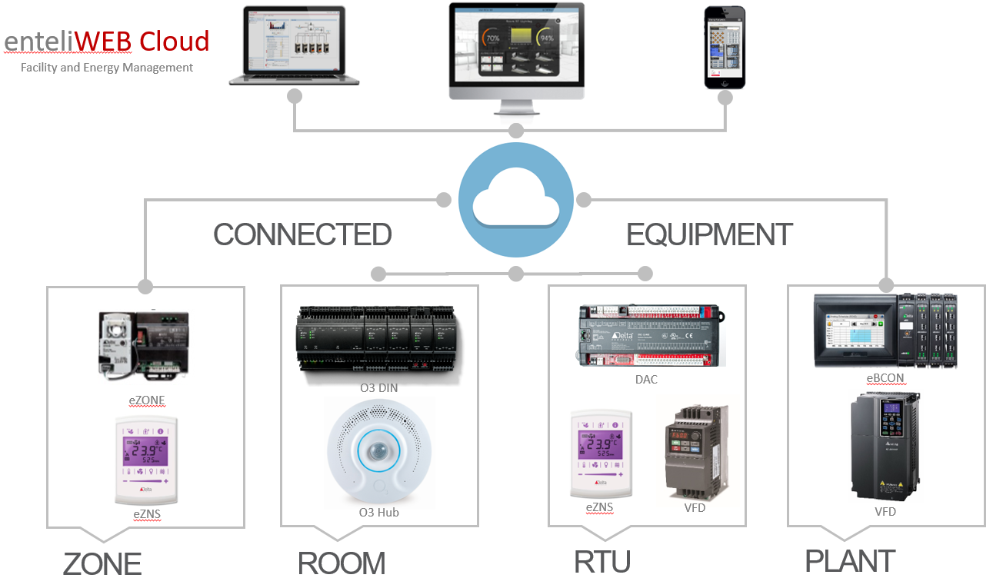
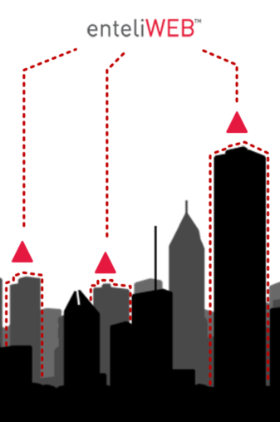
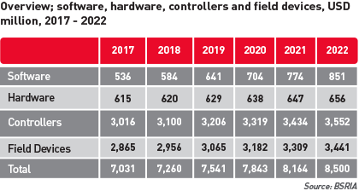

What
Market TAM = $641M, CAGR 10%
TAM
10% CAGR - Growing faster than controllers
or field devices
Opportunities
Value Proposition
Early to market
Mature, best of breed web based software, can make the jump to cloud/SaaS to capitalize on competitors’ weakness – device based software or Windows based software
Recurring revenue - Increase yearly revenue, lessen sawtooth
Data – Direct customer/market data
Transform your company into a data-driven IoT company with enteliCLOUD. Change one-time equipment sales to recurring revenue, by offering value-add services. Smart, cloud connected equipment, enables visibility, analysis, and savings for you and your customers.

Slide 4


Target Buyer
Primary target: Small to Medium size sites
Individual small sites that can’t effectively host own eWEB.
  Churches, light commercial, retail
Groups of small sites.
  Retail chains, self storage
Medium Sites
  Commercial buildings
  Property management co’s

Slide 5
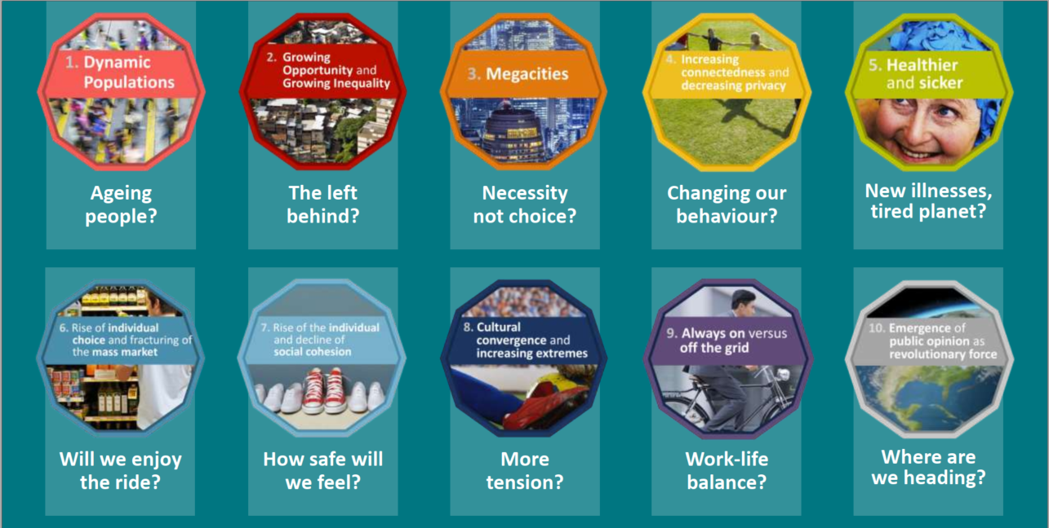
10 Mega-Trends
Growing Population
Urbanization Megacities
Increasing connectedness & decreasing privacy
Longer Life &
Unhealthy living
Rise of Individual choice & fracturing of the mass market
Notes:
Ipsos 10 Mega-trends for 2020
Particularly interesting given our Covid-19 situation. And of particular interest for the BABG:
Ageing people: increase in healthcare, people tracking, automation (for a number of reasons)
Megacities: increase # building, increasing complexity, Gov’t specs increasing to meet multiple demands
Increasing connectedness, decreasing privacy: people more connected to their environment not just each other, potential for employers to gain and use more personal info, access to health data
Healthier and sicker: focus on personal health – will carry over to workplace and home environments
Rise of individual choice: people want to control their environment – more occupant demands
There are other connections to be made here. What is interesting to me is that it appears all these trends will drive the requirements that our buildings provide more information and offer more flexibility. I’ve termed this as a need for an internal neural network, or a building nervous system.

Slide 6
Mega-Trends
Growing Population
Urbanization Megacities
Increasing connectedness & decreasing privacy
Longer Life &
Unhealthy living
Rise of Individual choice & fracturing of the mass market
Telecom Infrastructure
5G Deployment
6G Deployment
Energy Management
2019
$30/sq ft
2019
Today
User Enhancements for Productivity (APPS/ML/AI/AR/VR)
$300/sq ft
$30/sq ft
Connected Lighting
$300/sq ft
$30/sq ft
Health/Wellness/Safety
$300/sq ft
$30/sq ft
Cybersecurity
NIST Cybersecurity Framework
2019
2020
2021
2022
2023
2024
2025
2026
2027
2028
2029
2030
North Americas Left Wing Populist Growth and Global Slowdown
49 Average Age of a
Facility Manager
4.5 Billion Internet Users
BACnet SC Certifications
75% are Millennials
8.5 Billion 60% of people
Live in urban areas
Protocol Standards
Workforce
ISA 62443 BA Certification
Retrofit/Refurb Focus
Data Privacy/Security
Global Population
Cybersecurity
Average Facility Manager is a Millennial
US Election Accelerated Energy Regulations
Slower Economic Growth Healthcare
Government
Workforce
Government
Progressive Countries reach Carbon Neutral
LPWAN (NBIoT, LTE-M) Mass availability
Government
Protocol Standards
Connected Home
General Embedded ML
Protocol Standards
Core Processing
OCF 2.1 Adoption
Protocol Standards
Notes:
What Trends we feel are really driving our future today
Over the years in good times and tough times we’ve done okay (new construction or retrofit)
We sell to businesses that are driven to survive
The big shift we see impacting things is the shift in populism and government change
We see that same shift in the workforce and the generational change
We see the loss of trust and concern for health and safety
These are the things driving what we do now and into the next 10 years
Government change
More global government regulations around healthcare
More global government regulations around energy
Workforce change
Shift to the next generation with the loss of some knowledge and the transfer of knowledge occurring through different methods (online, video, AR)
More flexibility
Less trust
Constant connectivity and improved throughput
Value of technologies will change over time
Example energy
Example health and wellness

Slide 7
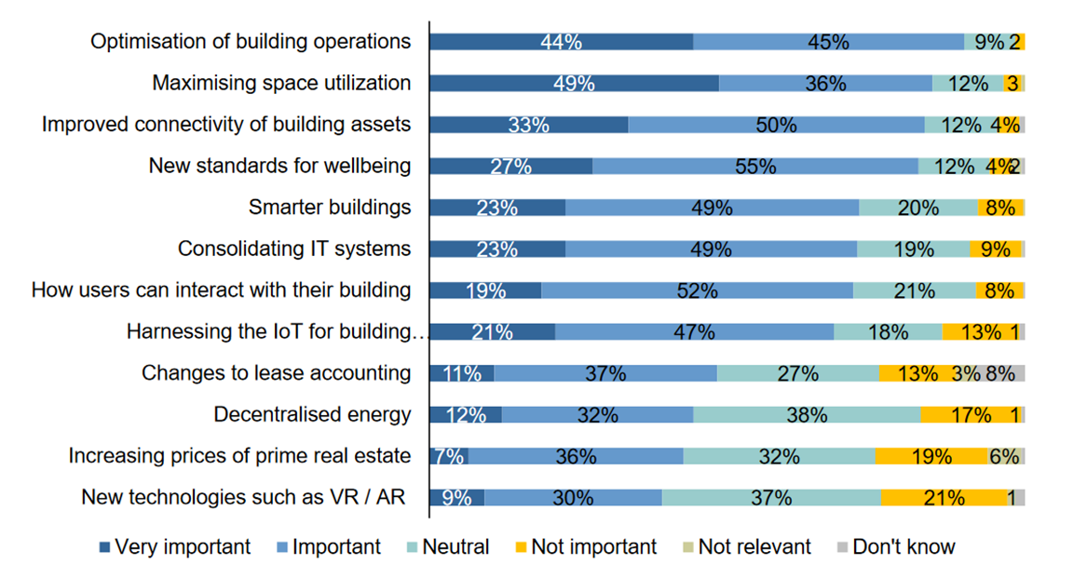
Verdantix – Real Estate and Facilities Directors Manage a Broad Change Agenda
“How important will the following market trends be in shaping your company’s real estate strategy over the next 3 years?”
Optimization of building operations
Optimization of building operations
Maximizing space utilization
Maximizing space utilization
Improved connectivity of building assets
Improved connectivity of building assets
New standards for wellbeing
New standards for wellbeing
Smarter buildings
Smarter buildings
Consolidating IT systems
How users can interact with their building
Harnessing the IoT for the building
Changes to lease accounting
Decentralized energy
Increasing prices of prime real estate
New technologies such as VR / AR
Verdantix Global Survey 2017-18 Real Estate Facilities

Slide 8
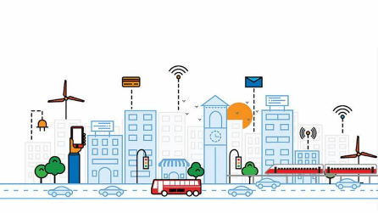
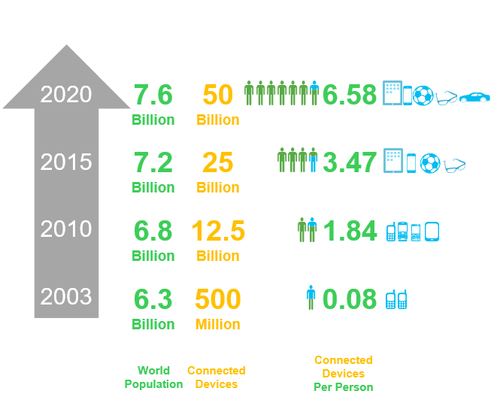
IoT and Cloud is a Main Driver in Building Automation
Connected devices has grown to 50B
29 billion connected devices by 2022
Ericsson’s research projects 29 billion connected devices by 2022, and the majority ─ 18 billion ─ of those will be IoT devices for applications like buildings, transportation, and the grid, surpassing consumer phones and laptops.
Connected Device Growth

Slide 9
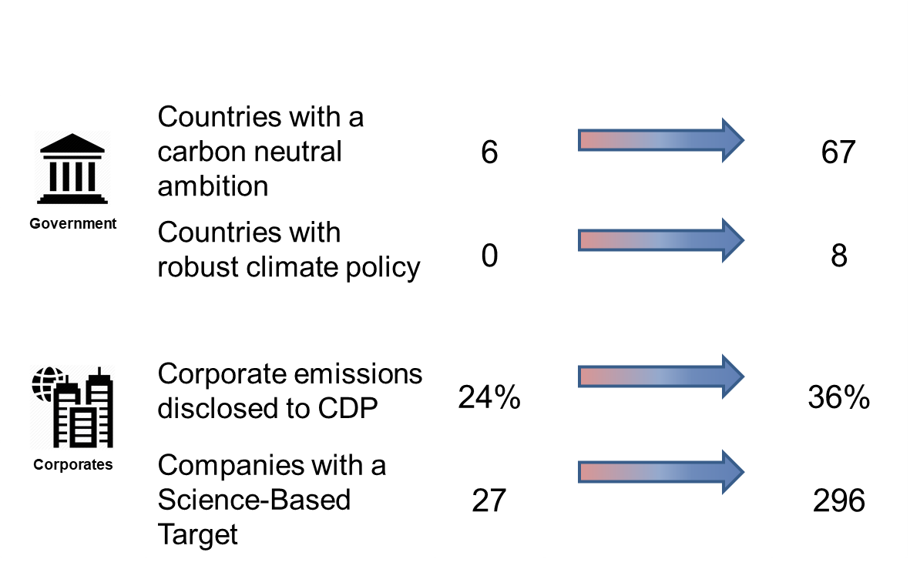
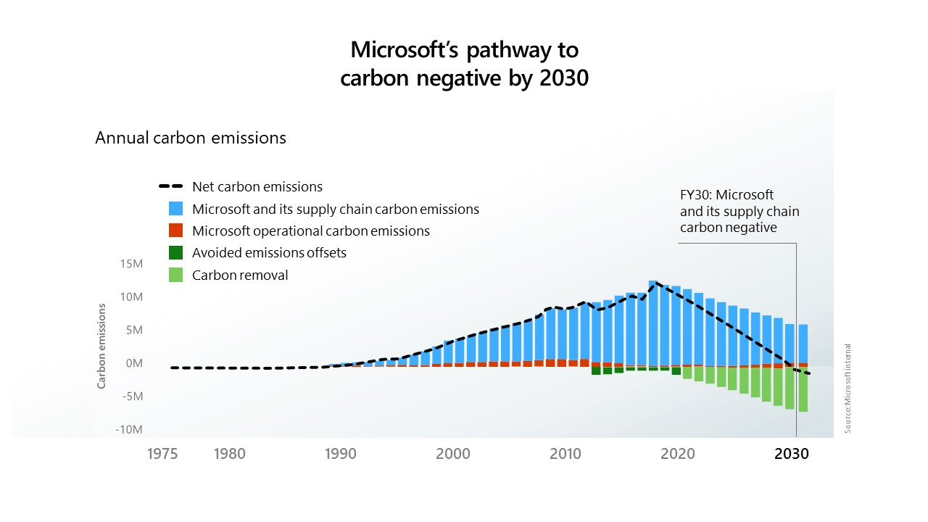
Cloud & IoT – Enabling Tech for Carbon Reduction
Climate Change & Energy
Energy Analytics & Prediction
Anomaly Detection
Energy Alerts and Actions
Delta Electronics Synergies
Self Generated Meters
Government Regulations
Formal Reporting
Notes:
Our areas of focus in the coming years has had some adjustments to it due to these current global trends
Climate Goals of Governments
Climate Goals of Corporations
Expect more formal reporting
More value with prediction
Move to AI making the decisions albeit less major
Flexibility in the systems due to uncertainty

Slide 10
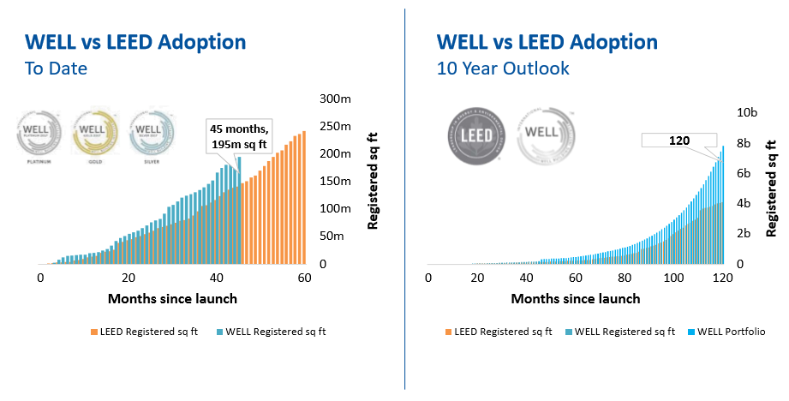
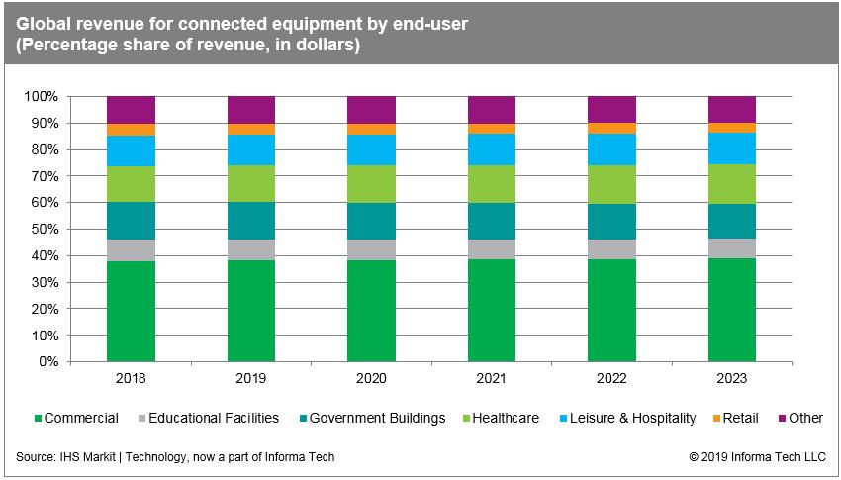
Cloud & IoT – Already used for LEED, now WELL
Healthcare & Wellness
13.9% CAGR for IoT in the Healthcare sector
WELL standard growth beyond LEED
More Data connectivity
More touchless products
Notes:
Our areas of focus in the coming years has had some adjustments to it due to these current global trends
Healthcare and Wellness will be elevated
Wellness standard is growing
Largest CAGR in the vertical markets
More analytics around the sensing of our health and safety conditions
More touchless products
More data connectivity

Slide 11
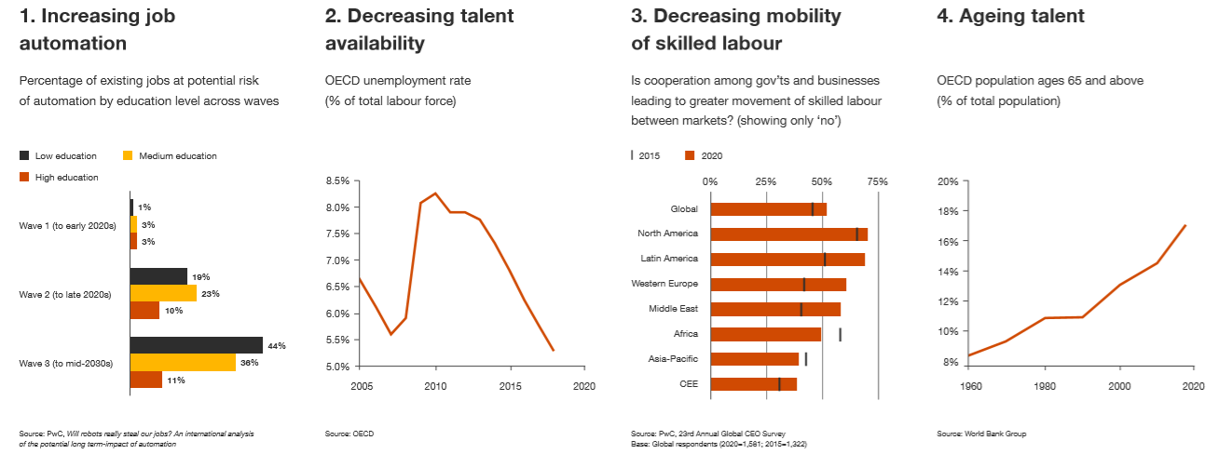
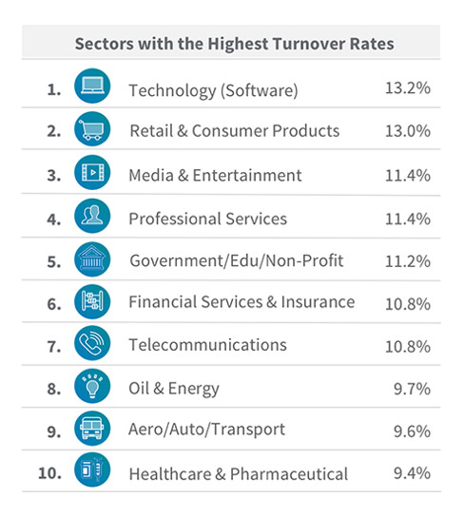
Cloud & IoT – Needed to Compensate for Skilled Labor Shrortage
Skilled Labour Shortage
Expect this to continue in the software discipline
Focus on accommodating newer workforce expectations
Do more with less
Collaborative Tools
Integration to Changing Business Processes
Empowerment Tools
Notes:
Our areas of focus in the coming years has had some adjustments to it due to these current global trends
Skilled labour shortage will continue even with a higher unemployment
Software is still highest shortage
Do more with less mentality
Focus on collaborative tools that empower and excite users
Provide for flexibility in integration and changing business processes

Slide 12
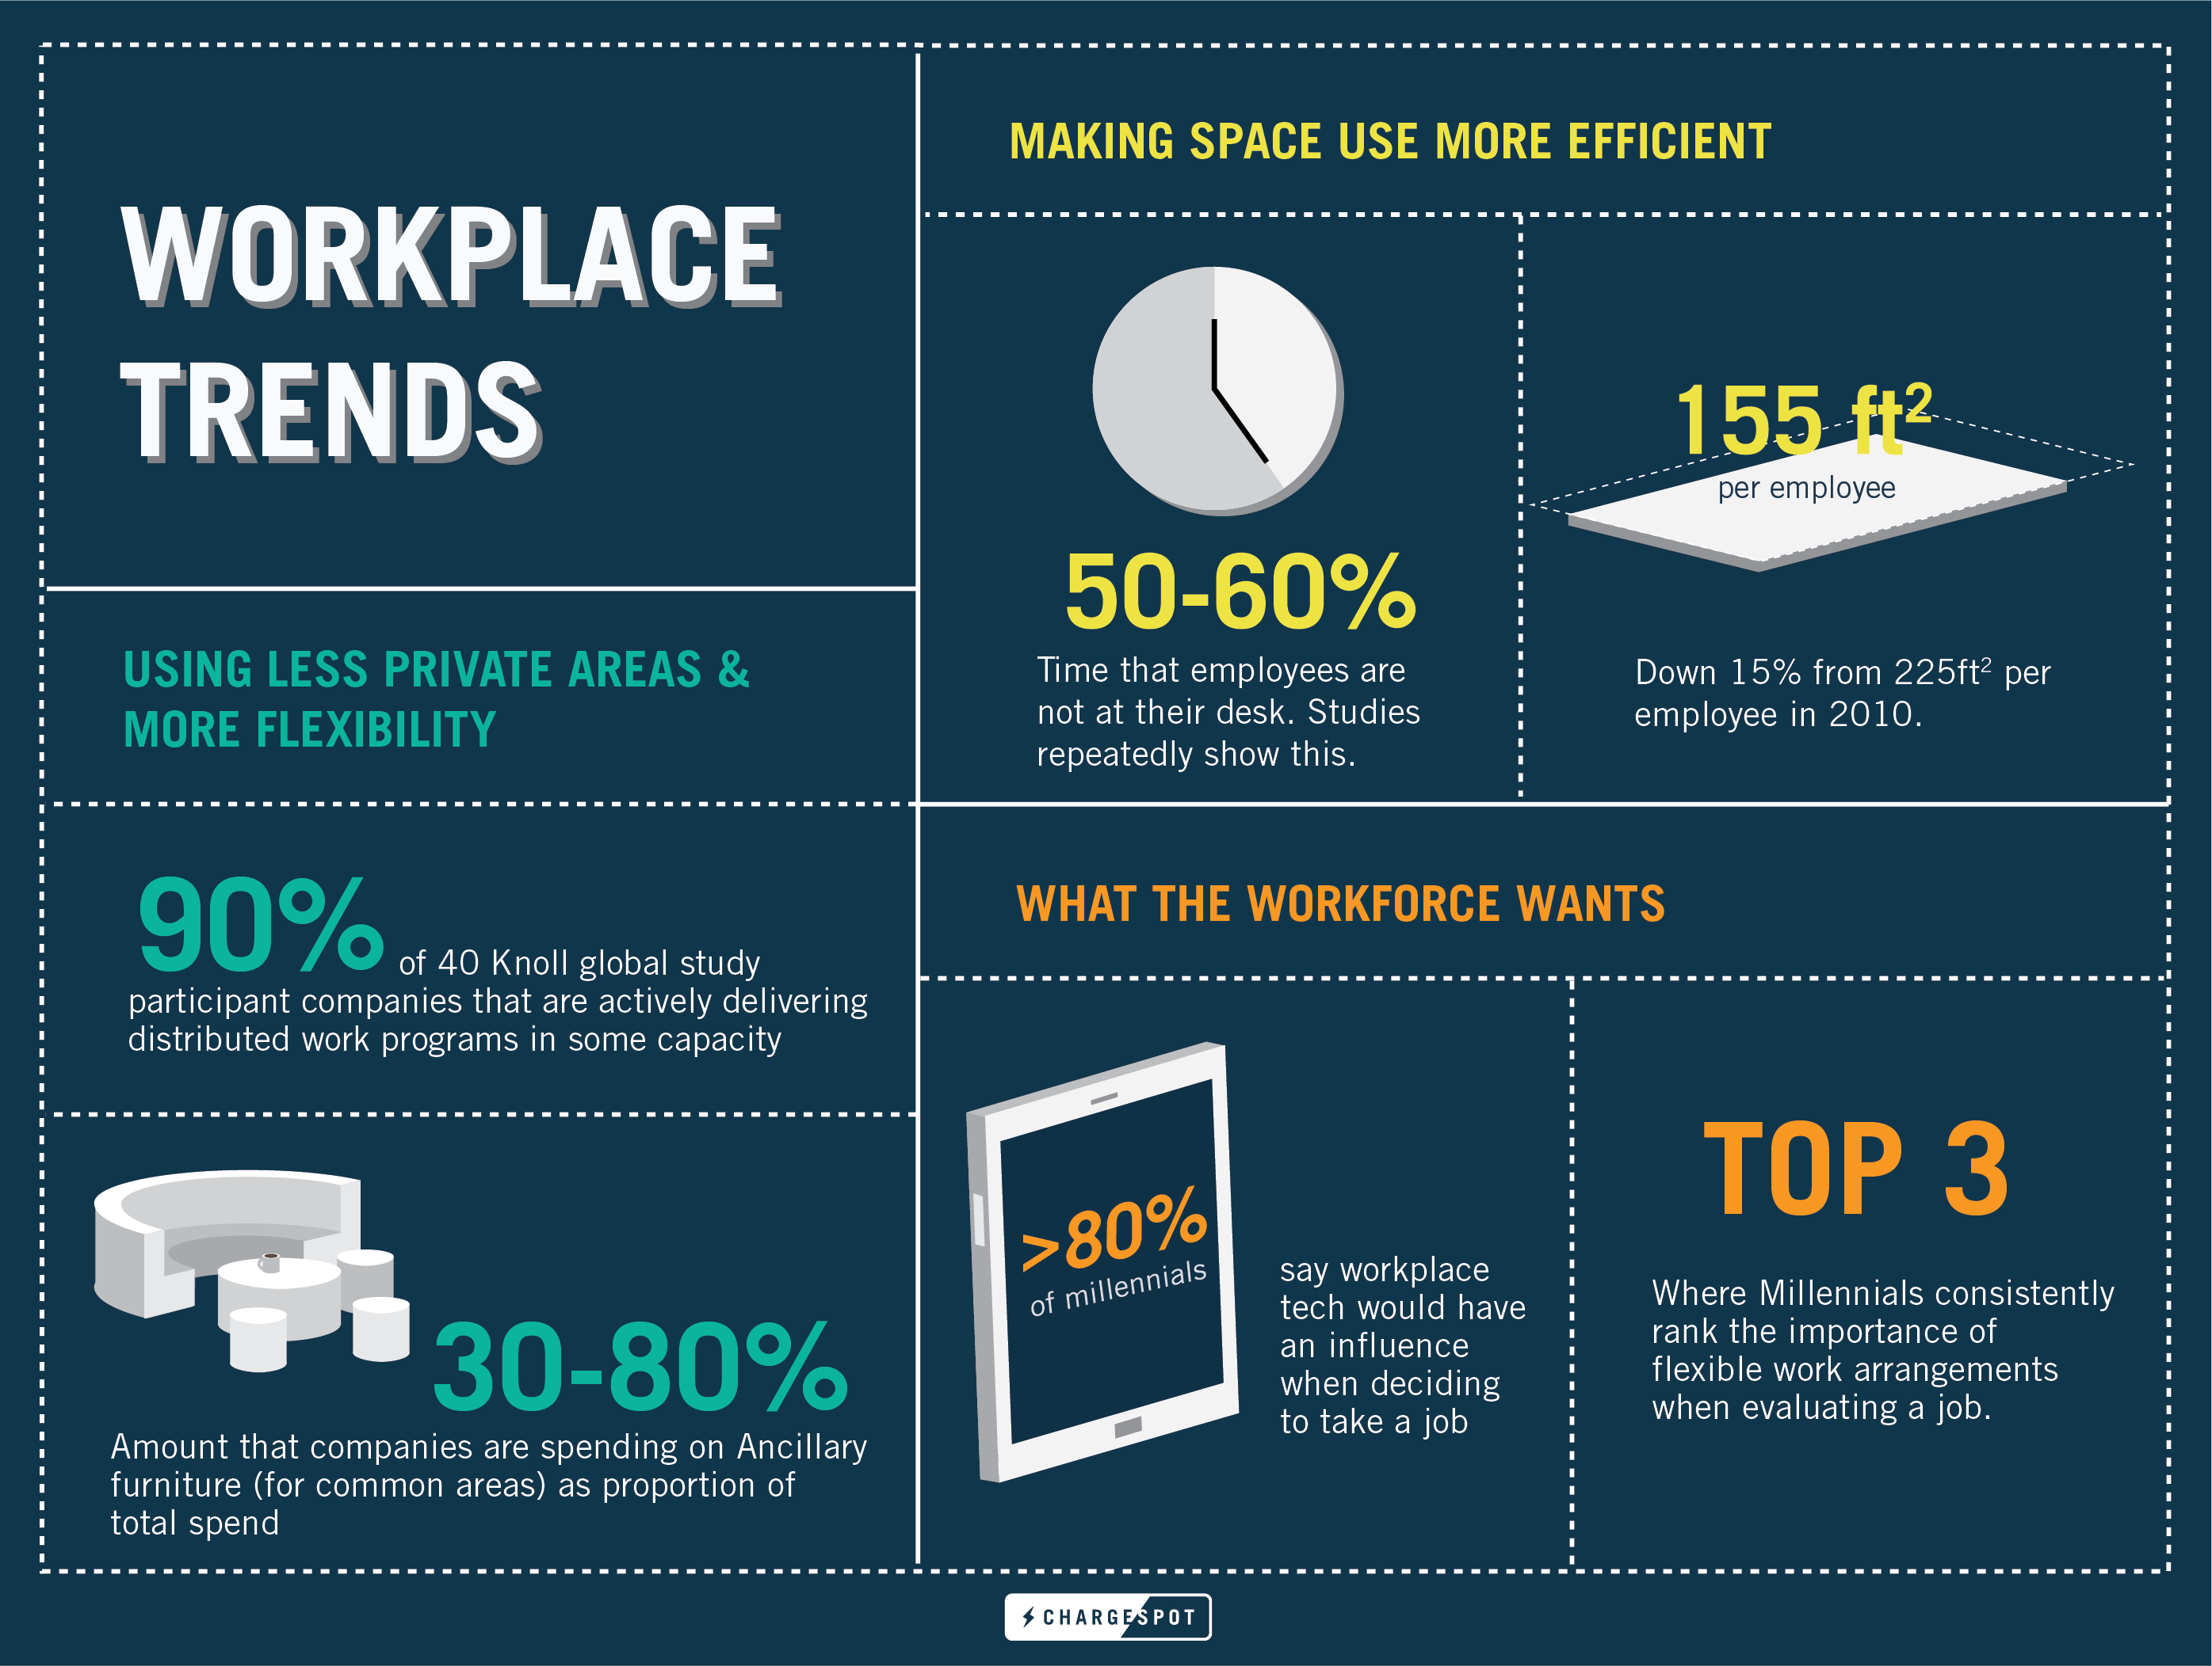
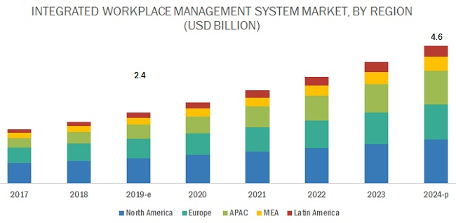
Cloud & IoT – Flex Workspace Needs Flexible Tech
Productivity
IWMS CAGR 14.2%
Adapting to a Changing Workforce
Flexibility
Mobility
Space Utilization
Comfort (Lighting, HVAC, Audio/Video)
Adaptive Systems
Virtual Assistants
Notes:
Our areas of focus in the coming years has had some adjustments to it due to these current global trends
Productivity
Focus on doing more with less
Flexibile workplaces
Integration with IWMS
More mobility (explain)
Focus on the mobile devices
Office space may reduce or change but more important o manage
Comfort is lighting, hvac, audio, video
Virtual assistance and adaptive systems

Slide 13
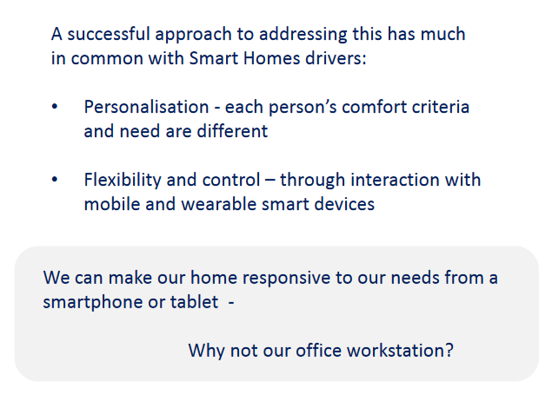
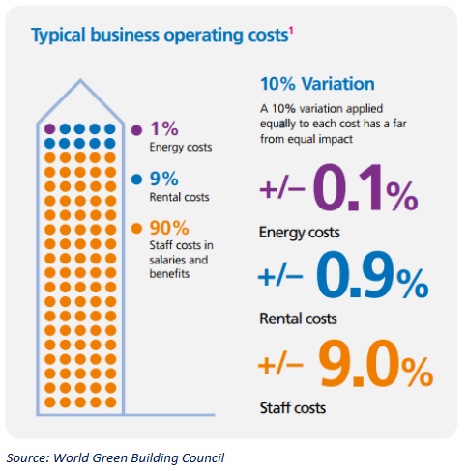
More on Productivity and IoT Trends
Commercial Expectations
Driven from Residential IoT
Productivity – 1 – 9 - 90
IWMS CAGR 14.2%
Adapting to a Changing Workforce
Flexibility
Mobility
Space Utilization
Comfort (Lighting, HVAC, Audio/Video)
Adaptive Systems
Virtual Assistants
Notes:
Commercial Expectations Driven from Residential IoT
Our personal IoT devices, smarthome tech and wearables, drives expectations. Why can’t we have this at work?
Productivity – 3 – 30 - 300
Gains in productivity enabled by better building environment, has far greater payback than energy.

Slide 14
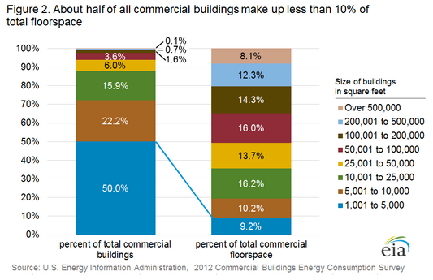
Market by Floorspace
Size of Buildings
Small buildings < 100,000 sq ft account for 65.3% of total commercial building floor space
Buildings between 100,000 and 500,000 sq ft account for 26.3% of total sq ft.
Large buildings account for just 8.1% of total sq ft.
https://www.eia.gov/consumption/commercial/reports/2012/buildstock/

Slide 15
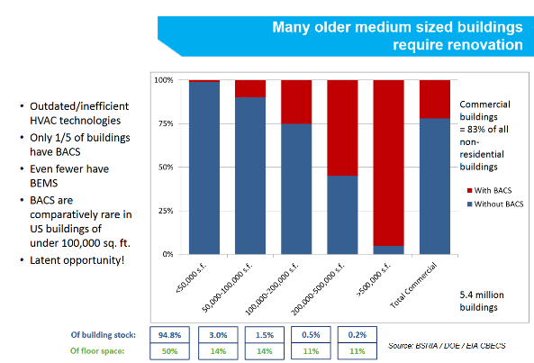
Small Buildings – Underserved Market
Small Building IoT
Outdated/inefficient technologies
Only 1/5 buildings have BACS
BACS comparatively rare in US Buildings under 100k sq ft
Fewer have BEMS
Therefore, a solution that provides benefits to the small building market will have a significantly larger retrofit base.
Most buildings under 100,000 sq ft have no lighting control systems
New code requirements will likely drive into this market segment
A solution offering LED fixture replacements for this space combined with simple, easy to install LCS has large potential.
Notes:
Virtually all large buildings have a building automation system
Very few small to medium sized buildings have an automation system. Reason? Can’t afford full time employees to manage each building.
However, with Cloud and IoT, you can connect to hundreds or thousands of smaller buildings. Now facility managers become affordable and can manage/optimize building performance from a remote location.

Slide 16
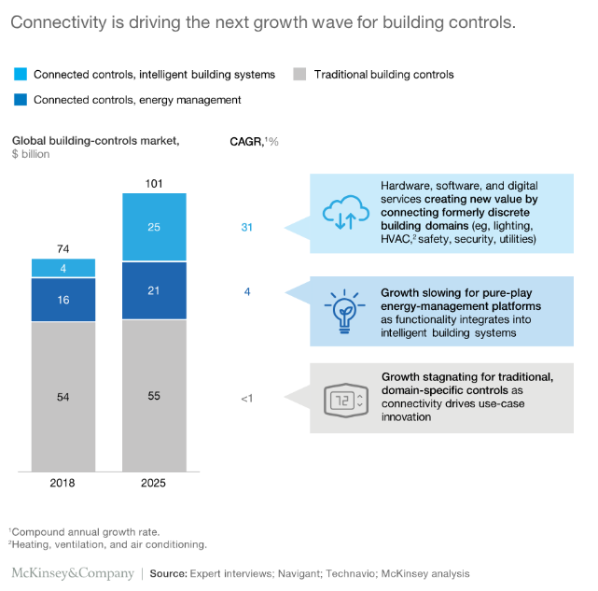
Integrated BAS / Convergence Will Win
Integrated BAS mean
Interoperable Controls
Connectivity Not Just IoT But Between Systems
  Critical elements for growth:
    Device connectivity
    Digital services
    Software
  McKinsey predicts controls companies that connect HVAC, lighting, security etc. with software and digital services will experience rapid growth, while traditional controls vendors will stagnate.
  Global TAM growing to $25B in Connectivity space with 31% CAGR (2108 to 2025)

Slide 17
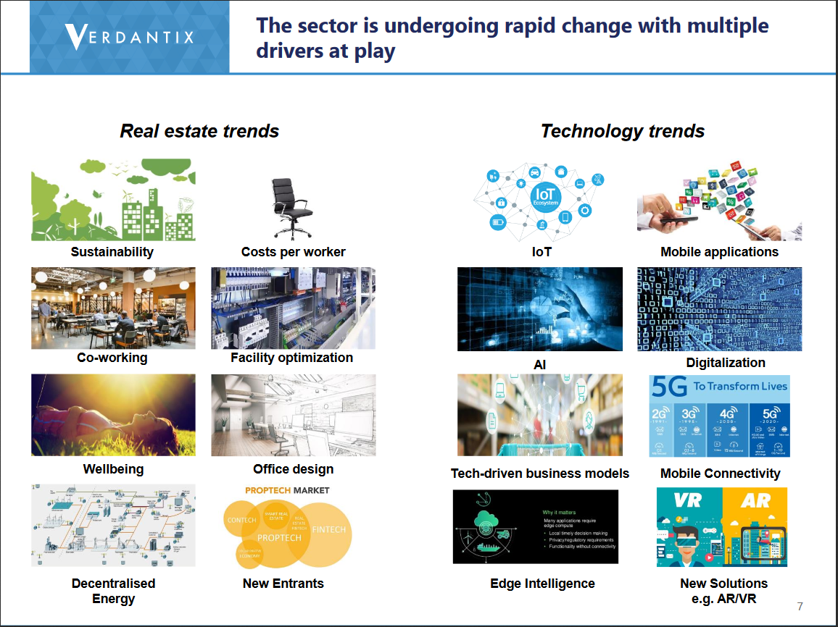
Real Estate Portfolio and Operational Management, Space and Workplace Services
The Connected Building
‘Software for real estate, facility
management, maintenance and energy
combined with smart building technologies and related consulting and implementation services that enable building owners and managed service providers to enhance the performance of individual facilities, improve worker productivity and optimize the financial management of a portfolio of buildings’

Slide 18
Cloud Based BMS

Slide 19
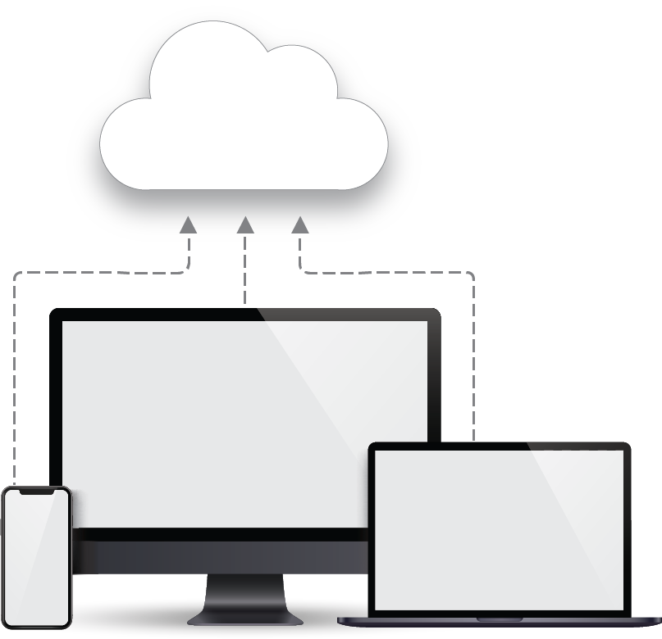
  enteliCLOUD is a web-based SaaS (Software-as-a-service) engineering and management tool that connects all your equipment and facilities, and gives facility managers and engineers convenient access to building management operations and energy analytics through a web browser.
Notes:
It is a two fold vision
Allow customers to access eWEB without installing it locally on a site or server or VM
Updates and maintenance will be handled by us
It is essentially SaaS that is hosted remotely and can be accessed over the internet. We host, set up, secure and maintain the instances in the cloud for the customers.

Slide 20
ARCHITECTURE
Cloud eWEB Portal
entelicloud.com
Partner A
Partner B
Multiple Customers
PartnerA.entelicloud.com
School District
sdmc.entelicloud.com
Multiple Customers
PartnerB.entelicloud.com
Owner Access
Owner Access
Internet
Internet
BACnet/SC
Controller
Site 1
BACnet/SC
Controller
Site n
BACnet/SC
Controller
Site 1
BACnet/SC
Controller
Site n
BACnet/SC
Controller
Site 1
BACnet/SC
Controller
Site n
Sell sites to different owners and provide access or monitoring/operation services.
Sell multiple sites to the same owner. Owner can operate entire portfolio of sites.

Slide 21
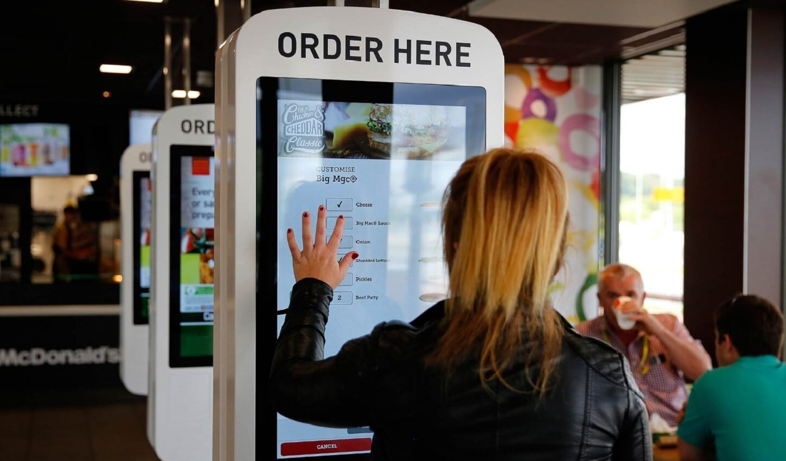
Features
Self Service – create enteliCLOUD instances yourself
  No email/call to Delta
  Adjust them as sites grow
Passport integrated
Automated monthly billing
Notes:
It is self service where user can create their own instance and sites using the intuitive UI. They can manage it by themselves.
No need to call tech support or technicians. Login to the portal and with a few click create an instance. Can be done in minutes. They can add sites and instances using the edit option.
We will cover details in the next slides
Since passport integrated, one less password to remember and no separate access required.
Billing is handled by Delta automatically in the background as per schedule so customer does not need to take any action from their end. We will go over the details when we talk about pricing.

Slide 22
Unique Selling Points (USPs)
Streamline installation – enteliCLOUD.com installs and configures instances of eWEB automatically – work goes from a couple of hours to minutes.
Work on the go – cloud access from anywhere, any device
No need to upgrade – Delta automatically upgrades eWEB for you 3 times per year
Reduced deployment variations – always the most up to date version
Enhance security – BACnet/SC and HTTPS
Increase revenue – monthly recurring revenue for partners
Notes:
Streamline installation:
It’s easy to set up and get started in minutes.
Saves time by letting partner set up enteliCLOUD instance before it gets installed, e.g. sites, admin account, add-on features.
No need to upgrade:
Customers will get immediate access to the latest features and bug fixes without lifting a finger. Our DevOps will take care of all the upgrades.
Work on the go:
Customers can securely access their enteliCLOUD instance from any computer.
Reduce deployment variations:
This will make maintenance and support easier.
Enhance security:
(soon) Monitor security issues. Uses BACnet SC and HTTPS for better security.
Increase revenue:
Save money on installation, maintenance, and support. Because it is a subscription based model it acts as a recurring revenue or partners.

Slide 23
Unique Selling Points (USPs)
Cloud based BMS/EMS with encrypted site connections using BACnet/SC*
No special** hardware needed on site
No up front licensing costs
Only pay for what you use
No installation / licensing / upgrades
No ongoing server maintenance
Geolocation
  US West, US East, Europe, Asia, Australia
* What is BACnet/SC you ask? See https://support.deltacontrols.com/Support/Webinar/BacnetSecureConnect
** You will need a Delta device capable of BACnet/SC (eBUS-2 or O3 with 4.9+ firmware)
Notes:
Cloud based BMS/EMS with encrypted site connections using BACnet/SC. To know more about that you can go to the webinar listed below.
You will need one controller that can do BACnet SC, moving forward many products will support BACnet SC by default so you will not need an extra hardware to connect.
Don’t have to buy eWEB license anymore, much lower upfront capital
Pay only what you use based on IO points and that can be upgraded or downgraded based on your needs, things change over time and you can edit those parameters and the pricing adjusts accordingly.
No installation, upgrades and maintenance is required. All handled by Delta. Part of the value that we add.
When you create an instance You can pick the location for instances that makes sense to you. We have a number of time zone options you can select from. We will go over it during the demo.

Slide 24

enteliCLOUD + eWEB USPs for Owners
Operational Excellence
Reduce costly emergency service technician visits by pre-diagnosing problems and fixing them remotely
Unburden your IT and Facility Management team from maintaining servers and software.
Monitor, operate and control your portfolio of buildings across a geographies in a single pane of glass
Deliver a consistently exceptional employee and customer environment that leads to higher productivity and revenue.
OPERATIONAL
EXCELLENCE
INCREASE
PROPERTY
VALUE
ENERGY
SAVINGS
Property Value
Increase the value of your portfolio by leveraging aggregate data on building performance and employee and customer satisfaction scores
Make better business decisions on individual properties in your portfolio based on building performance data
Remotely monitor and control buildings from home, the office, or on the go, without requiring on-site staff.
Energy Savings
Reduce energy usage with a portfolio-wide strategy
Manage renewable energy sources in conjunction with energy consumption
Notes:
eCloud features help customers to align with the bigger organizational goals of achieving operation excellence, increasing property value and increasing energy savings
Because it is self service , it not only streamlines installation process but that ties u to reducing resources, time, and cost related to IT, facility management.
Have control of the entire portfolio and make portfolio wide strategy to improve business decisions

Slide 25
eWEB On-Prem Server vs eCLOUD Comparison
 | eWEB On-Prem installation | eCloud
Installation process | Tech operator follows all steps in the installation guide, IT set up, licensing, server set up | Intuitive (user-friendly) Does not require additional access certificates, or licensing
Server Hardware Cost | $650 - $5500 (Small to Large sites) | $0
Server Lifespan | ~5 years | Unlimited
Installation Duration | 4-16 hours/yr (Partner @ $125/hr) 4-16 hours/yr (Customer IT dept @$65 Hr) | 5 - 10 minutes (Partner @$125/hr) 0 hours (Customer IT dept @65/hr)
Maintenance effort | 8-40 hours/yr (Partner @ $125/hr) 2-16 hours/yr (Customer IT dept @$65 Hr) | 0 hours (Partner) 0 hours (Customer IT dept)
Upgrades | User initiated, optional, can choose to work with outdated versions | Auto initiated, scheduled updates, access to latest versions at all times with new features, bug fixes, and security patches
Convenience | Installation on site | Installation from anywhere with an internet connection, on any device, and at any time (outside office hours)
Do it right. | deltacontrols.com
Notes:
Installation guide: https://support.deltacontrols.com/Products/EnteliWEBInstallGuide

Slide 26
Risk Reduction as a USP
Security, Security, Security
Service Agreement
Disaster Recovery

Slide 27
Security
Security as part of development process
  Security Threat Risk Assessment (STRA)
  Two Factor Authentication for all services
  All instances secured by HTTPS
  BACnet Secure Connect for all site connections
eCLOUD users can enable 2FA for portal
Notes:
Security is a huge part of eCloud.
As part of the New security development lifecycle we now include the STRA. For eCloud it was done by a third party contractor named Iron Sphere – done an exercise to look at known attack factors and identify how we can handle them. If anything was identified as a high risk, it was fixed in eCloud 1.1
Who wants to access the google cloud platform itself (Such as Delta employees) – google is 2 factor – first account login – password is stolen – disable account – user configuration – admin in eCloud stuff.
We no longer use BBMD connection, we now have to use BACnet SC. No non encrypted traffic going to.
security best practices document is still being developed
eCloud also has the 2FA for users. So if you go to the user profile there is an option to enable the 2FA. The users needs to download an authenticator app on their device (phone etc) and scan an QR code. To receive security code generated by the app + the eCloud password to gain access to eWeb

Slide 28
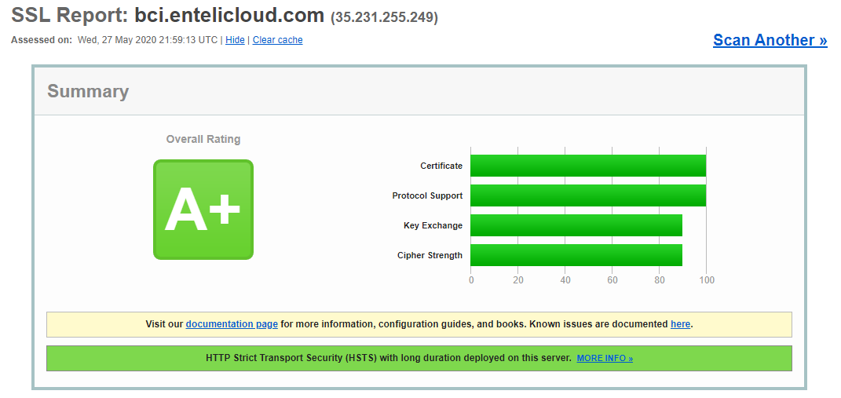
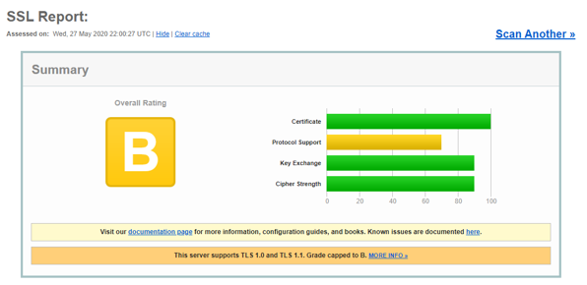
Security
eCLOUD
Partner Installation

Slide 29
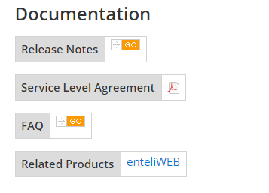
Service Level Agreement
98.0% uptime guarantee
  Credit for any time we fail to meet the commitment
  Measured quarterly
Excludes scheduled downtime
  48 hours notice
  Up to 10 hours per year
Effective Feb 1, 2020
  Subject to change
Notes:
If it is available 95% of time then you will get credit for the 3% downtime. Amount is calculated quarterly and Credit you for the amount it is. (Dave can elaborate on how that works in terms of billing)
We will only do scheduled maintenance as per the window defines . Anything beyond 10 hours would be
The document link? Is it published?

Slide 30
Disaster Recovery
Nightly backup in cloud
Off-site tertiary backup by Ops team
Notes:
We also support disaster recovery since there is a nightly back up and also an offsite tertiary backup, in case the partner or user messes accidentally deletes or changes something that they may want to revert.

Slide 31
Pricing

Slide 32
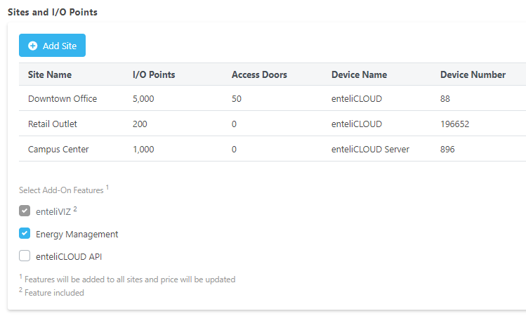
Pricing
Monthly charge per instance
  Cost based on I/O per site
  Add-on O3 access doors per site
  Add-on energy to instance
  Add-on API to instance
Minimum charge
PO set per instance
Notes:
When you create sites you provide IO points, access doors and add ons etc based on which the monthly cost is calculated.
There is a minimum charge restriction on the site which
There is a purchase order set for each instance and billing is done based on each PO

Slide 33
Small Site Pricing – Retail, Light Commercial
Not the normal partner market
  This is a good thing!
eCLOUD and Delta hardware is a good fit
eCLOUD pricing for small sites is based on volume
  Competition is very low cost: Non comm t-stat, Nest, Pelican etc
Notes:
- The logic behind how this cost is calculated can be seen in the eCloud Quote tool
- customers are also given the eCloud tool which is basically an formula based excel to calculate cost and play around, make adjustments and see

Slide 34
Billing
Invoices generated on 22nd
Prorated for created/deleted dates
January 2020
February 2020
SUN | MON | TUE | WED | THU | FRI | SAT
 |  |  | 1 | 2 | 3 | 4
5 | 6 | 7 | 8 | 9 | 10 | 11
12 | 13 | 14 | 15 Created | 16 | 17 | 18
19 | 20 | 21 | 22 Generate invoice | 23 | 24 | 25
26 | 27 | 28 | 29 | 30 | 31
SUN | MON | TUE | WED | THU | FRI | SAT
 |  |  |  |  |  | 1
2 | 3 | 4 | 5 | 6 | 7 | 8
9 | 10 Deleted | 11 | 12 | 13 | 14 | 15
16 | 17 | 18 | 19 | 20 | 21 | 22 Generate invoice
23 | 24 | 25 | 26 | 27 | 28 | 29
Notes:
Invoices are generated every 22nd.
There is an automated workflow - DevOps initiates Billing process on eCloud – request is sent to Great plains through online ordering API and Econnect. RMA admin then send the invoice to customer.
Prorated – You pay for what you use.

